Slide 1
Ancient China Power Point
Vocabulary and Study Guide

Slide 2
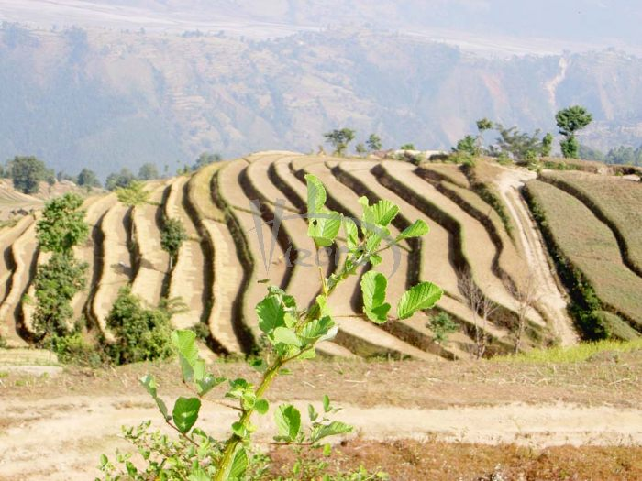
Terraced Farming
Definition: Farming on land that has hills/slopes
(a “terrace” is a narrow, flat field carved out of a hill or mountainside)
Connect: To make good use of every bit of land, and to keep the rains from washing away all the dirt, farmers in China used terraced farming.

Slide 3
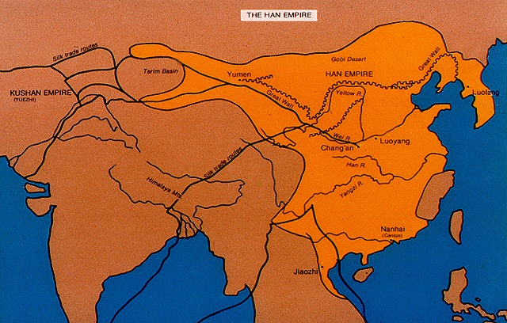
Civilization
Definition: People with Government, Religion, Economics/Education, Artisans/Agriculture, Technology, and Social Classes; civilizations develop near water
Connect: The Huang He Valley (or Ancient China) was a civilization, because it had all of these things!

Slide 4
Dynasty
Definition: Rulers from the same family for many generations
Connect: China was ruled by many (more than a dozen) dynasties, including the Shang, Zhou, Qin, Han, Ming, etc.

Slide 5
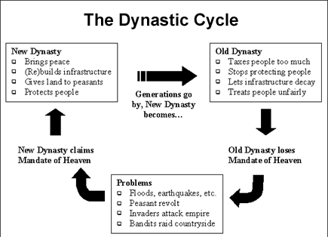
Dynastic Cycle
Definition: Cycle of rulers, showing why/how one dynasty comes to an end and another begins
Connect: Liu Pang helped overthrow the Qin Dynasty rulers, and used the “Mandate of Heaven” to justify his rule, beginning a new dynasty, the Han Dynasty.
Another Connect: In earlier years, the Zhou used the “Mandate of Heaven” to claim they had the right to start a new dynasty over the Shang Dynasty, because they said the Shang ruler at the time had been an evil man.

Slide 6
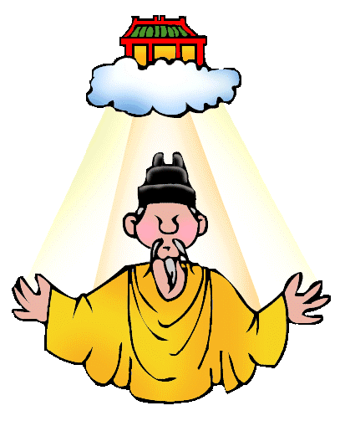
Mandate of Heaven
Definition: A belief that the Chinese emperor’s right to rule came from the gods; and that the gods and ancestors blessed the right and fair king; The Mandate of Heaven says that governments may rule so long as they:
*rule fairly,
*benefit the people, and
*perform the proper religious duties.
Connect: The Zhou claimed they had the “Mandate of Heaven” and the right to rule after the Shang, because they said the Shang ruler at the time had been an evil man.

Slide 7
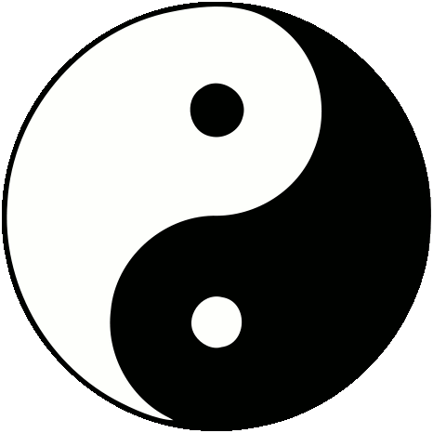
Daoism or Taoism
Definition: A relaxed and natural way of finding happiness; A belief that everything arises from the Dao (a silent, pure, all-powerful force that existed before heaven or Earth) *Daoists believe we should live in harmony with nature, lead simple lives, and not act in anger. They also believe in the opposing forces (energies) known as “Yin and Yang”.
Connect: Daoism was one of the three popular religions (or philosophies) of Ancient China (Confucianism, Daoism, and Buddhism).

Slide 8
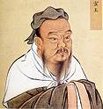
Confucius
Definition: Chinese philosopher (thinker); created philosophy known as Confucianism
Connect: Confucius believed and taught:
*respect for elders
*education is important
*governments should rule fairly (and hire people qualified for the jobs)
*DUTY is central idea of Confucianism
*Golden Rule!

Slide 9
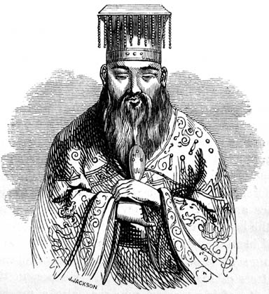
More About Confucianism
Leaders should set an example
Civil service exams over Confucius’s teachings were required to work for the government
Confucius taught order in society
People should respect those above and below them in society
Education valued
Respect for elders valued

Slide 10
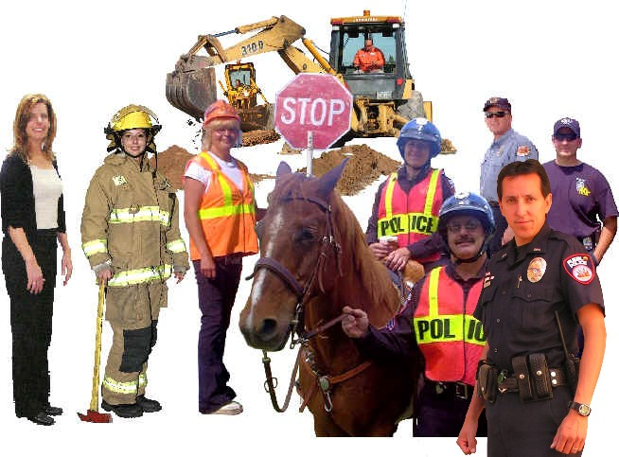
Civil Service
Definition: Working for the government (government jobs)
Connect: Confucius taught that you should have to go to school, take classes, and pass a test in order to be a civil servant (someone who works for the government). In other words, to work for the government, you should be QUALIFIED – not just get the job because you were wealthy or owned land!
Examples of duties of civil servants in ancient China:
*collecting taxes
*enforcing laws
*organizing workers for building projects
*judging court cases
*keeping official written records of the empire
*registering births, deaths, marriages, and changes in land ownership

Slide 11
Qin Shi Huangdi
Definition: China’s First Emperor, of the Qin (pronounced “Chin”) Dynasty
Connect: He defeated all the Warring States and united China; enforced tax-collecting; made standard money, writing, weights & measures, and roads; built roads, canals, and palaces; and began connecting pre-existing walls to construct what became known as the Great Wall of China

Slide 12
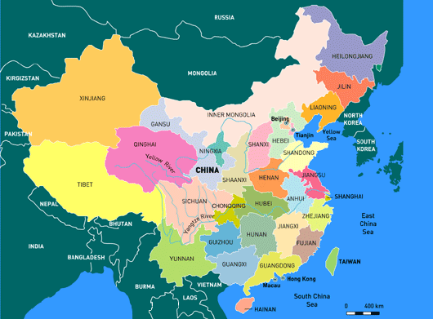
Provinces
Definition: A political division of land
Connect: Emperor Shihuangdi divided China into provinces to make it easier to rule

Slide 13
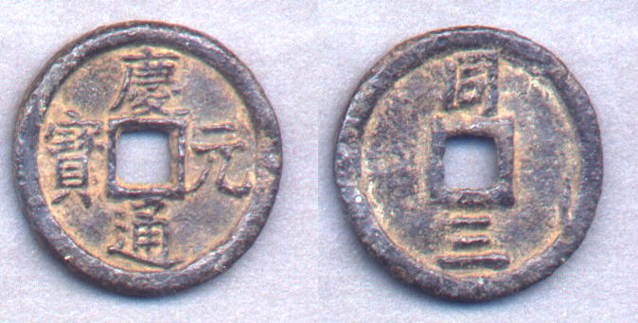
Currency
Definition: another word for money
Connect: Shihuangdi made a common currency to help make trade easier

Slide 14
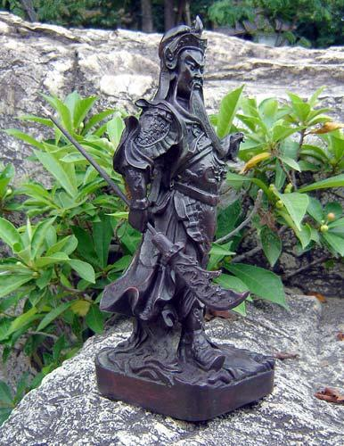
Warlords
Definition: military leaders who lead their own armies; governed local territories in the kingdom as appointed by the king
Connect: Shang Dynasty kings relied on the warlords to stay in power

Slide 15
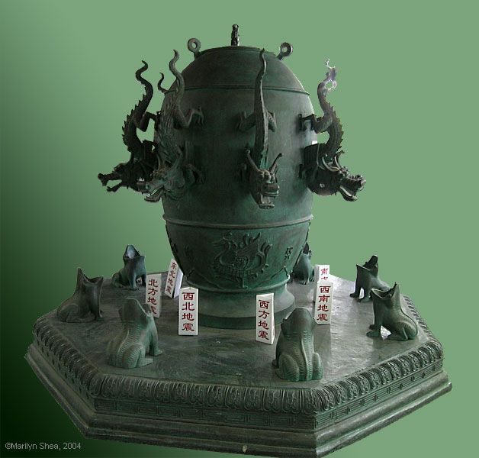
Seismograph
Definition: an earthquake detector
Connect: an important Chinese invention kept in the capital city, which allowed rulers to know when and where an earthquake would occur; and helped them know where to send food and supplies immediately following an earthquake

Slide 16
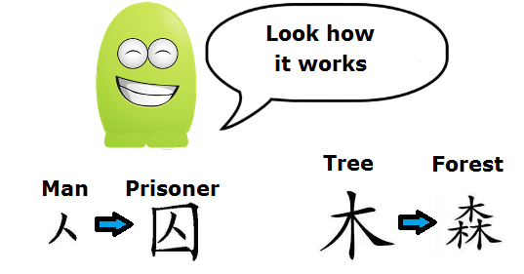
Ancient Chinese Writing
PICTOGRAPH
a character that represents an object
IDEOGRAPH
a character that links (combines) two or more pictographs together to represent an idea

Slide 17
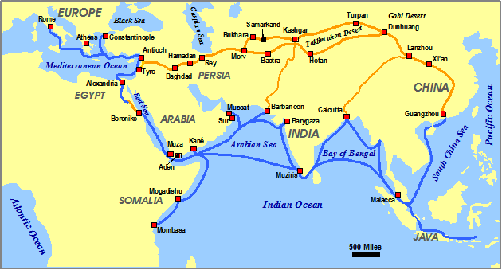
Silk Road
Definition: the trade route from China to Rome
Connect: Silk, spices, and other goods traveled the Silk Road to be traded. Other things, like religious ideas, diseases, and inventions, were also spread via the Silk Road.

Slide 18
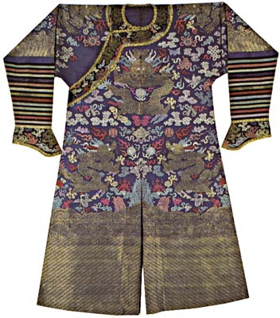
Silk
Definition: soft material made from the cocoons of silk worms
Connect: important export from China; the Chinese were the only ones who knew how to make it for many centuries, so it was very popular and sought-after by other countries (expensive, too!)

Slide 19
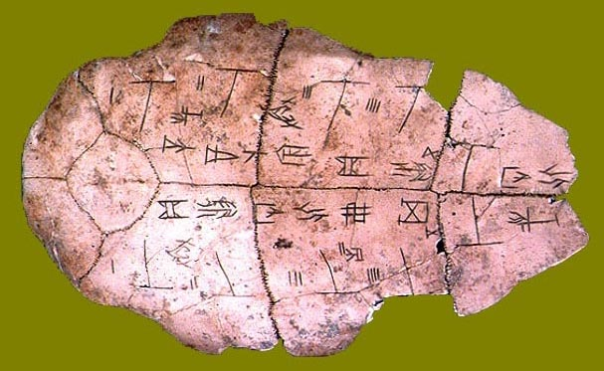
Oracle Bones
One important duty of the king was to contact the gods and ancestors before making important decisions. The kings used ORACLE BONES to help them do this. Priests would scratch the king’s questions on the bones and then heat them over a fire until they cracked. The pattern of cracks provided answers from the gods and ancestors to the king’s questions.

Slide 20
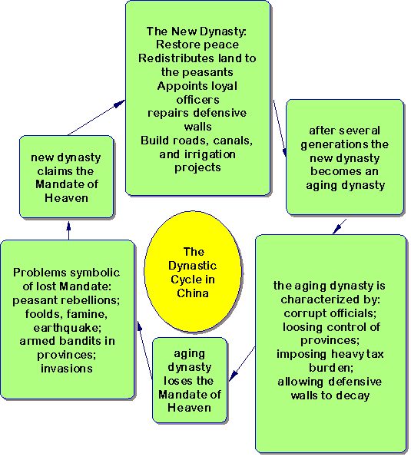
The Mandate Of Heaven
From Zhou dynasty
Rulers must be fair to people
Rulers must follow the religious duties
Rulers must honor ancestors
If a ruler is evil or doesn’t do duties, he must be removed

Slide 21
Dynastic Cycle

Slide 22
Accomplishments of Shi Huangdi’s Rule and Their Impacts
Accomplishment Under Shihuangdi’s Rule | Impact It Had on China
United China | Larger country with more people and resources to defend the empire Continued to be united from this time forward
Made a common money system with coins and weights and measurements | Trade was easier
Built roads | Faster transportation of goods and army
Built irrigation | Improved farming and increased crops
Divided into provinces with common laws | Organized government
Common writing system | Communication easier
Helped continue building the Great Wall | Protection from northern invaders Road for army to travel

Slide 23
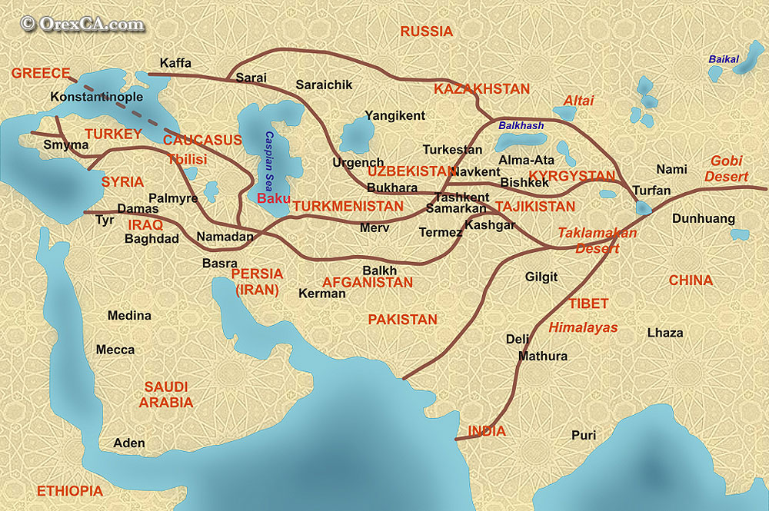
Other Items That Traveled Along the Silk Road BESIDES SILK!
pottery
spices
paper
religion
diseases
inventions
people (slaves)

Slide 24
Ancient China
Location | Landscape (What the the land looks like) | Resources in Ancient China
Asia Along the Huang He (Yellow River); and later, the Chang Jiang, or Yangtze River (Long River) | Gobi Desert in the north Himalaya Mountains between China and India Fertile land along rivers’ valleys Terraced farming Steppes (dry, treeless plains) north of the Huang He | Bamboo to make paper Silk worms to make silk Huang He provided water to irrigate crops

Slide 25
Accomplishments/Inventions and Impacts (There were many others besides these!)
Invention | Significance
Compass | Improved navigation; allowed ships to travel farther
Gunpowder | Used in war - caused damage to equipment and killed enemies; led to development of gun, bomb, rocket, land mine…also used in fireworks for celebration
Paper | Export; made printed documents/books cheaper
Printing Blocks (Wood Block Prints) | Books and documents could be printed faster; everything didn’t need to be printed by hand
Iron Plow (Cast-Iron Plow) | Faster and improved farming
Ship Rudder (Stern Post Rudder) | Ships could be steered more easily; larger ships; could carry more cargo

Slide 26
Why is the Huang He often referred to as “China’s Sorrow” or “China’s Curse”?
The Huang He is called “China’s Sorrow” or “China’s Curse” because sometimes it can flood too quickly or too much and cause a lot of death and destruction to people and/or crops. ☹
How did the the Huang He get its name?
The Huang He gets its name from the dusty, yellow soil, called loess, that washes into the river and makes it a muddy, yellow color. “Huang” means yellow. “He” means river.

Slide 27
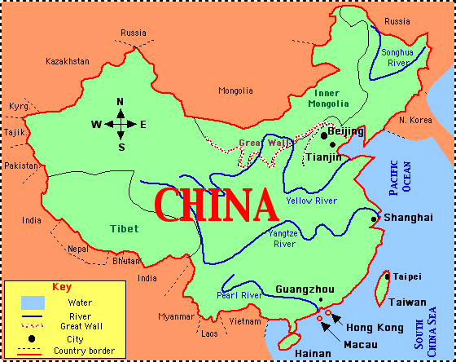
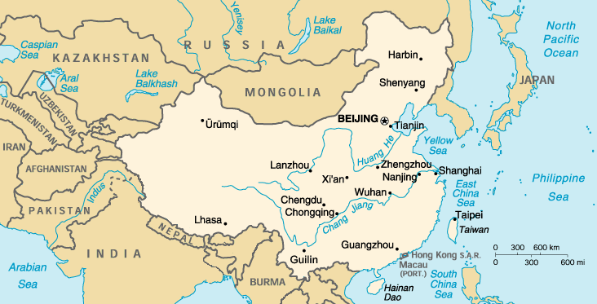
Besides the Huang He, what is the other major river of ancient China?
Chang Jiang, which means “Long River”
(This river is also known as the Yangtze River.)

Slide 28
What things were the Qin and Han Dynasties well-known for?
QIN DYNASTY
Unification of China
Standardized (single system of) writing
Legalism
Standardized money
Standardized weights and measures
Built roads, canals, and palaces
The Great Wall
HAN DYNASTY
Wheelbarrow
Confucianism
Paper-making
Silk-weaving
Seismograph
Cast-Iron Plow and other farming tools made of iron
Waterwheels
Stern Post Rudder for ships
Acupuncture

Slide 29
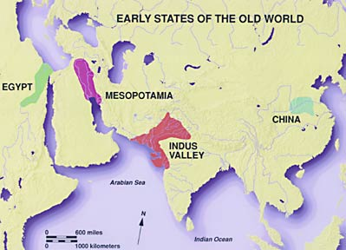
MAP OF CIVILIZATIONS

